Slide 1

Programming pradgism - Functional programming -
Lambda $λ$

Slide 2
Intro
Lambda function is an anonymous function, which is used only one time.
(a, b) => {
return a + b;
}
Javascript
\a b -> a + b
Haskell

Slide 3
1. Lambda function
map (\x -> x + 3) [1, 6, 3, 2]
is equivalent with:
increase3 x = x + 3
map increase3 [1, 6, 3, 2]

Slide 4
1. Lambda function
ghci> zipWith (\a b -> (a * 30 + 3) / b) [5, 4, 3 ,2, 1] [1, 2, 3, 4, 5]
[153.0, 61.5, 31.0, 15.75, 6.6]

Slide 5

1. Lambda function: Excercise
Reduce list of tuple [(a, b)] to list of sum of elements in tuple.
Example: [(1,2), (3,5), (6,3), (2,6), (2,5)] $→$ [3, 8, 9, 8 ,7]

Slide 6
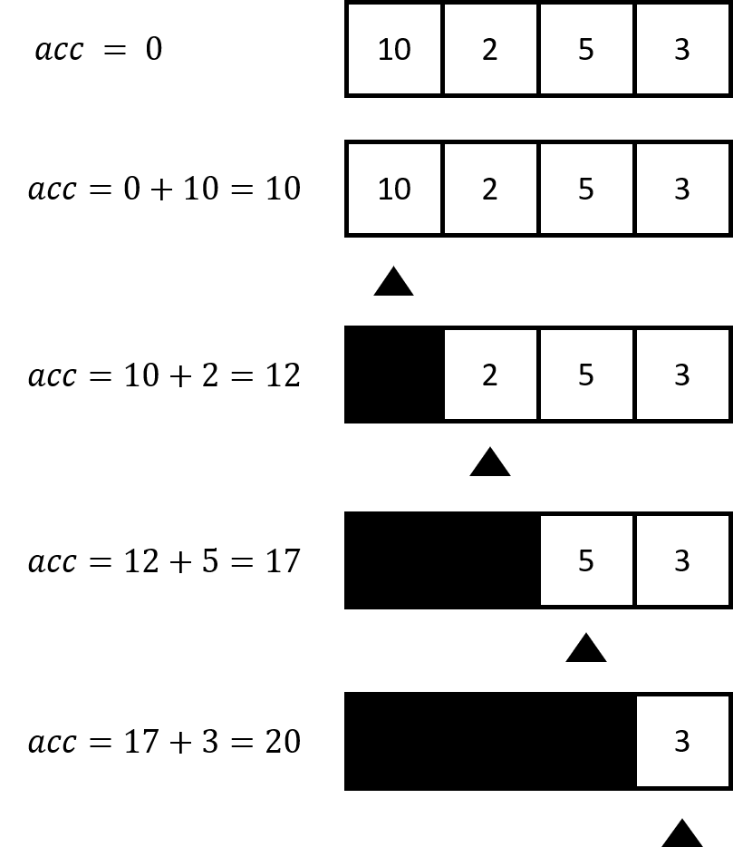
2. More details about reduce (fold)
sum' :: (Num a) => [a] -> a
sum' xs = foldl (\acc x -> acc + x) 0 xs
or:
sum' :: (Num a) => [a] -> a
sum' = foldl (+) 0

Slide 7
2. Fold: excercise
Re-defind filter function by foldl and lambda function

Slide 8
3. $ operation
$ is the application infix
($) :: (a -> b) -> a -> b
f $ x = f x

Slide 9
3. $ operation
The different:
take 1 $ filter even [1..10]
-- = [2]
and:
take 1 filter even [1..10]
and:
(take 1) (filter even [1..10])

Slide 10

4. Homework
a) Define quick sort function
quicksort :: (Ord a) => [a] -> [a]
b) Find $x_{max}≔maximum\left(\left\{x∈ℕ,x<100000,x⋮3829\right\}\right)$

